Slide 1

STAR Lab Pedestrian Detection Model Development Pipeline Intro

Slide 2
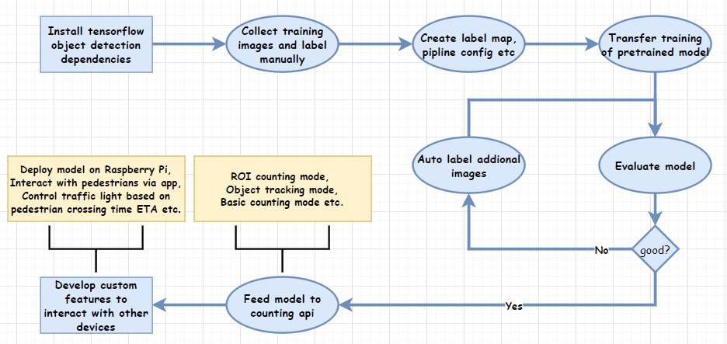
Development pipeline

Slide 3
Resource
Object detection guide: https://github.com/nicknochnack/TFODCourse
Raspberry Pi example model deployment: https://github.com/nicknochnack/TFODRPi
Image labelling tool: https://github.com/tzutalin/labelImg
Auto labelling tool: https://github.com/AlvaroCavalcante/auto_annotate
Object counting API: https://github.com/ahmetozlu/tensorflow_object_counting_api

Slide 4
Current issue
The object counting API is written in tensorflow 1.x, which is outdated. The custom model we trained has incompatible binary files to feed the API.
Where to find good resource on learning tensorflow object detection workflow. Function usage is also needed.
Latest model is not good enough due to limited training data size.

